Slide 1
Troubleshooting your Power BI Report Performance
Benni De Jagere

Slide 2





Benni De Jagere?
Senior Data Insights Consultant
Realdolmen, a Gfi company
.be
@BenniDeJagere
/bennidejagere
#TeamOxfordComma

Slide 3
Session Objectives
Leverage (external) options to pinpoint common causes
Techniques to avoid, or solve
Usable set of best practices
Not! a DAX or PowerQuery Performance Deep Dive

Slide 4
Why Troubleshoot Report Performance?
No one likes to wait
“Works on my machine” is not a valid reply
40% Science, 40% Art, 20% Luck
Context and Baseline are Key
Aim for quick wins on heavily used reports
Avoid long investigations on barely used reports (unless it’s the CFO)
It depends!

Slide 5

PowerBI.com
http://www.51mon.co.uk/photo/MrNoisyNeighboursMCFC.jpg

Slide 6
PowerBI.com
Shared Resources, blessing and curse
Premium Capacity does not automagically solve performance issues
Beware of Cache mechanisms

Slide 7
The Report Case

Slide 8

Use Case
https://elidesc.com/wp-content/uploads/2012/07/Velo_Antwerpen.jpg

Slide 9

New York Citibikes
www.citibikenyc.com/system-data
Public Open Data
Starts June 2013
Information about every trip
Longer than 60 seconds
Starts at public station
Masterdata
https://i0.wp.com/thenypost.files.wordpress.com/2013/12/citibike1.jpg?quality=90&strip=all&ssl=1

Slide 10
The Report(s)

Slide 11
The Tools

Slide 12
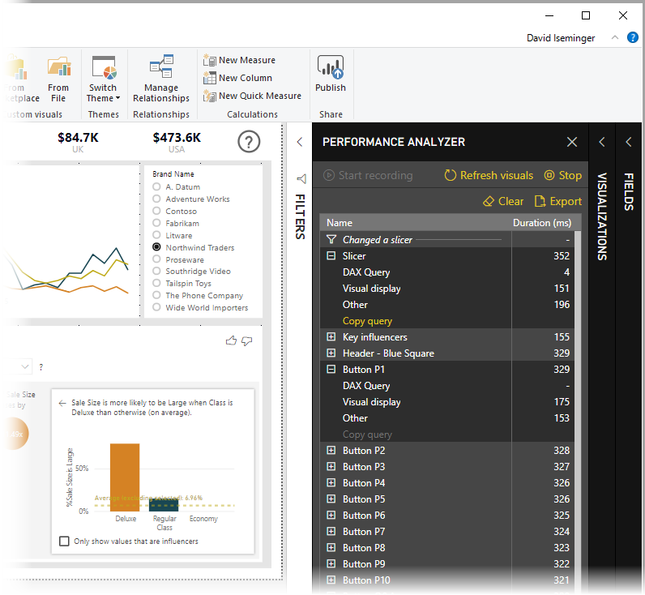
Performance Analyzer Pane
Public Release in May 2019
Flight Recorder for all operations
Breaks down execution times
Export results with ease
https://docs.microsoft.com/en-us/power-bi/media/desktop-performance-analyzer/performance-analyzer-01.png

Slide 13
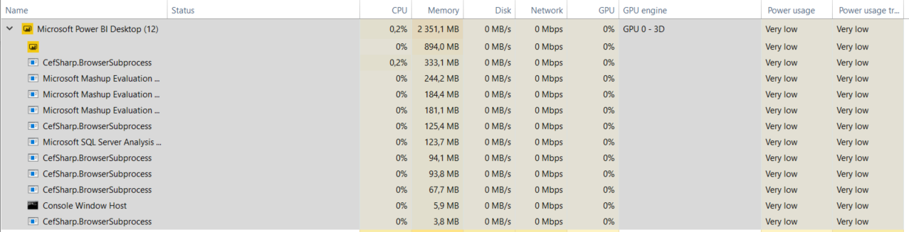
Inside Power BI Desktop

Slide 14

Tools for the Trade
http://www.clker.com/cliparts/9/6/7/c/1280887403729185486tool%20belt.jpg

Slide 15
Tools for the Trade
Performance Analyzer Pane
DAX Studio (SQLBI.com)
VertiPaq Analyzer (SQLBI.com)
Tabular Editor
Power BI Helper
Power BI Field Finder

Slide 16
The Tips & Best Practices

Slide 17
The Golden Rule(s)
Transform early
Transform once
Transform smart

Slide 18
Data Types

Slide 19
Auto Date/Time

Slide 20
Column/Row Usage

Slide 21
Modelling

Slide 22

Modelling Tips
Thanks, @KoVer ☺

Slide 23
Modelling Tips
Star Schema (all the things!)
Use persisted surrogate keys for relationships
Avoid Bi-Directional filtering (DAX Crossfilter)
Disable auto date/time, rather ‘Mark as Date Table’
Debate Role-playing dimensions
Optimize Data Types
Try setting “Assume Referential Integrity” on relationships – in many cases, this setting significantly improves query performance.

Slide 24
Modelling Tips (continued)
Avoid wide tables
Remove unused columns and rows
Only load queries that are used
Reduce inappropriate summarization
Think about your data granularity
Hide (or remove) Key fields from the model view
Consider your source and refresh schedule

Slide 25
PowerQuery

Slide 26
PowerQuery Tips
Query Folding, when possible
Don’t repeat tables & fields
Only load tables that are used in the model
Specify correct Data Types
Parameterize ‘fact’ queries (Date or Entity)

Slide 27
DAX

Slide 28
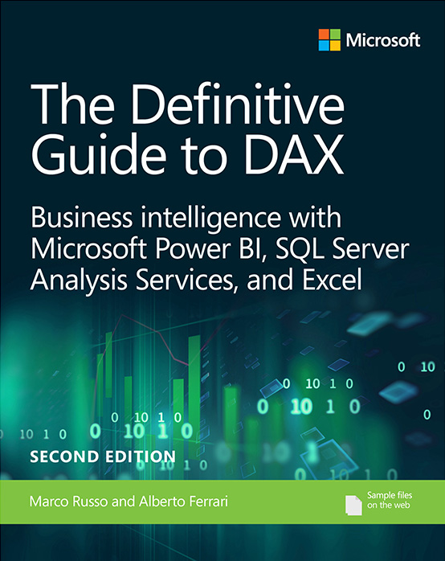
DAX Tips
Avoid ‘repeater’ functions (SumX, AverageX, ..)
Avoid calculated columns
Keep measures simple initially, and add complexity incrementally.
Use variables
Solve the model, then solve DAX
Use Data Categories
Read the Bible ☺

Slide 29
DAX Formula Engine & Storage Engine
Category | Formula Engine | Storage Engine
Query received | Interpret DAX/MDX formula | Can handle single logic (xmSQL) from formula Engine
Target Data | Iterate over datacaches produced by storage engine (datacaches are in-memory tables) | Iterate over compressed data in vertipaq column stores
Result | Produce result set and send back to requestor | Produce Datacaches send back to formula Engine
Thread | Single – Threaded | Multi – Threaded
Cache utilization | No | Yes
Area of focus for Performance Tuning | Check physical plan for bottleneck | Check xmSQL query for bottleneck

Slide 30
Reports

Slide 31
Report Page Tips
Limit visuals on a single pane
Filtering and slicing before rendering is a valid option (ie. Landing page, Report Filters, ..)
Avoid having 5+ report tabs on a single report
Avoid interaction between visuals when they’re not needed
Avoid overly detailed visuals
Be aware of render intensive visuals (ie. Maps, Custom visuals, ..)

Slide 32
Bonus Round

Slide 33
Composite Models & Aggregations
Composite models (and DirectQuery) require proper usage of DAX
Use these wisely
Aggregations cost memory, data refresh time
Solve specific performance issues

Slide 34
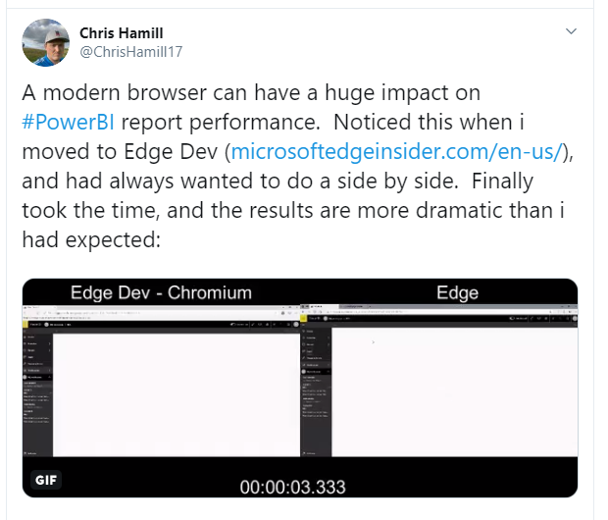
Battle of the Browsers
https://twitter.com/ChrisHamill17/status/1160242636369694720

Slide 35
Takeaways
Report performance should be thought of at design time
Think about your transforms
Modelling is key
Choice of browser matters
Create a personal set of best practices for Tabular Editor
Read public (online) resources

Slide 36
Resources
https://docs.microsoft.com/en-us/power-bi/power-bi-reports-performance
https://docs.microsoft.com/en-us/power-bi/guidance/import-modeling-data-reduction
https://docs.microsoft.com/en-us/power-bi/guidance/star-schema
https://sqlserverbi.blog/2019/08/24/power-bi-project-good-and-best-practices/
https://docs.microsoft.com/en-us/power-bi/desktop-performance-analyzer
https://docs.microsoft.com/en-us/power-bi/visuals/power-bi-visualization-best-practices
https://www.sqlbi.com/books/the-definitive-guide-to-dax-2nd-edition/

Slide 37
Resources
https://www.sqlbi.com/tools/
https://github.com/otykier/TabularEditor
https://powerbihelper.org/
https://github.com/stephbruno/Power-BI-Field-Finder

Slide 38
Benni De Jagere?
Senior Data Insights Consultant
Realdolmen, a Gfi company
.be
@BenniDeJagere
/bennidejagere
#TeamOxfordComma

